Slide 1
Covid-19 Exploratory Data Analysis
By:
Telak Ghimire
Yogesh Nayak
Deepanshu Singh

Slide 2
Objective
To understand the behaviour of Covid- 19 cases and it’s effects across India.

Slide 3
Data & Technology
Data Source
Link : https://data.covid19india.org/
Technology Stack :
Python used for data extraction and data cleaning.
SQL used for analysis .
MS-Excel used for visualization and dashboard.

Slide 4

Overview of Project
B
A
7 Day rolling average
Weekly evolution of number of cases
G
B
% Analysis across different metrics
Categorization of Districts by Testing ratio
ANALYSIS
F
C
Key Performance Indicators
Deaths across Categories
E
D
Comparison of Severity between two States
Monthly trend of Cases

Slide 5
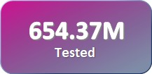
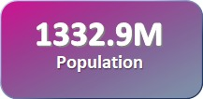
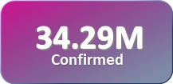
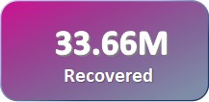
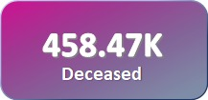
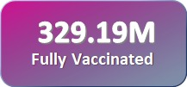
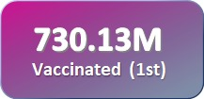
Key Performance Indicators

Slide 6
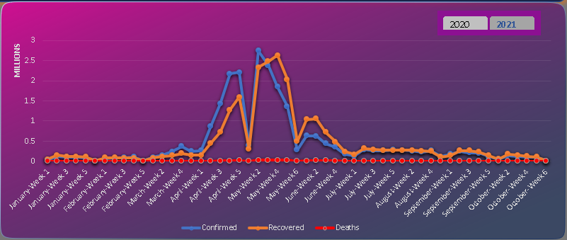
Weekly evolution of number of cases
Insights :
In 2020 the cases started from April week 5 and the highest recorded case was in September week 3 and deceased were also highest during same week.
In 2021 during the month of March there was a spike in cases, highest recorded cases were during second week of May while deceased were highest during the fourth week of May.

Slide 7
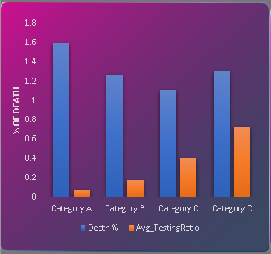
Categorization of Districts by Testing ratio
Insights:
Testing with respect to population is less in category A due to which death percentage is more.
While there was increase in testing ratio, the death percentage started declining.
Note:
Category A: 0.05 ≤ tr ≤ 0.1
Category B: 0.1 < tr ≤ 0.3
Category C: 0.3 < tr ≤ 0.5
Category D: 0.5 < tr ≤ 0.75
Category E: 0.75 < tr ≤ 1.0
‘tr’ = testing ratio

Slide 8
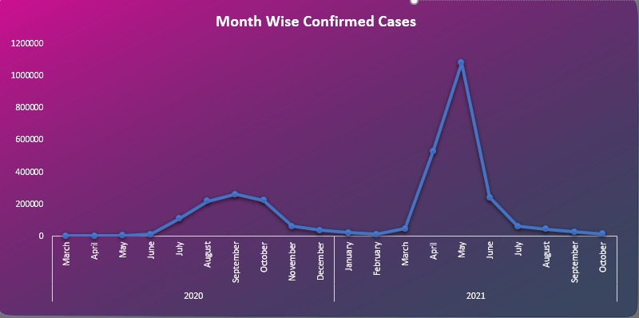
Monthly trend of Cases
Insights:
During 2020, in the month of June there was a spike in cases, highest was observed in September and after that cases stated declining.
During 2021, there was a sudden spike in cases during march, highest was observed in may and after that confirmed cases saw a steep decline.

Slide 9
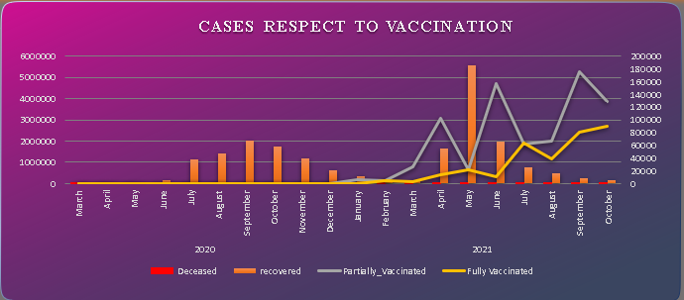
Insights:
In 2020, recovery rate was highest in October while there was no vaccination.
Due to increase in First dose of vaccination we can observe that recovery rate went up
After Second dose of vaccination, the confirmed cases declined resulting in less number of recovered and deceased cases

Slide 10
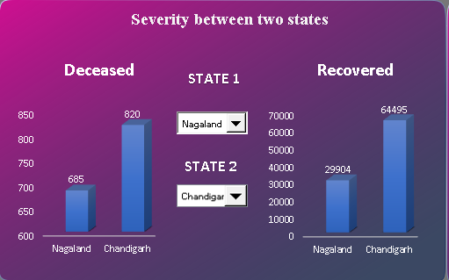
Comparison of Severity between two States
We can compare Deceased and recovery between two states

Slide 11
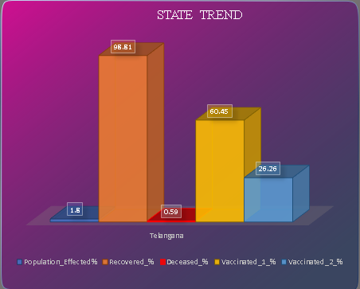
% Analysis across different metrics
The following analysis helps us understand the percentage of different metrics across various states.
In the following graph we can observe that in the state of ‘Telangana’ the recovery was 98.81% due to which percentage of deceased declined.

Slide 12
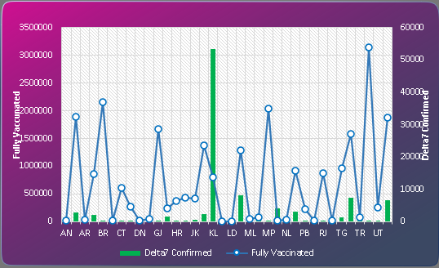
7 Day rolling average
Insights:
7 day average data of confirmed with vaccinated.
Highest number of cases were in ‘Kerala’ while vaccination were less in that state.
We can see that confirmed cases is dependable on vaccinations, more vaccination will lead to low confirmed cases.
Highest vaccination can be observed in ‘UP’ which resulted in less confirmed cases.

Slide 13
Conclusion
The above analysis concludes that if testing is less then people might have a greater chance of getting covid.
The recovery rate was greater as compared to deceased rate.
Percentage of fully vaccinated is less than 50% that of partially vaccinated.

Slide 14
Challenges Faced

Slide 15
Thank You

